Slide 1
Cardiac Output
Prof Deepthi de Silva
Department of Physiology
D de Silva

Slide 2
Objectives
Definition of the cardiac output & cardiac index
Measurements of cardiac output
Physiological variants of cardiac output
Derivation of the CO & factors altering the CO
Defining the factors that contribute to the preload
Frank Starling law of the heart
Factors increasing the contractility of the heart
Factors determining the afterload
D de Silva

Slide 3

Definition
The quantity of blood pumped by one side of the heart in a minute
  The left ventricle’s cardiac output is the same as the right ventricle’s output
Measured in Litres per min (L/min)
In an adult male in the supine position, it is around 5L/min
D de Silva

Slide 4
Why does the cardiac output change?
Physiologically-
Increased oxygen consumption by the tissue causes CO to rise
  Reduced oxygen consumption causes a fall in CO
Disease can also alter CO
  Increase CO- Thyrotoxicosis, fever, anaemia
  Reduce CO- Hypothyroidism, cold, cardiac failure
D de Silva

Slide 5
Calculation of the cardiac output
volume of blood pumped by a ventricle in a beat (EDV- ESV)
The number of heart beats per minute
CO = Stroke volume x Heart rate
CO = 70mL x 72/min = 5.040L/min
=(~5L/min)
D de Silva

Slide 6
Factors that alter Cardiac output
Anxiety/ excitement (e.g. examinations)
Eating
Exercise
Pregnancy
High external temperature
Adrenaline/ Noradrenaline
Sitting or standing from a lying position
Rapid heart rates
(heart disease)
D de Silva

Slide 7
What happens to alter cardiac output?
CO = HR x SV
Increasing the heart rate +/- stroke volume causes a rise in the CO
Decreasing the heart rate +/- stroke volume causes a fall in the CO
D de Silva

Slide 8
Increasing the heart rate
“Chronotropic effect”
Reducing the resting vagal tone on SAN*/ AVN**
Increasing the sympathetic discharge to SAN/ AVN
Increasing circulating catecholamine action on the SAN/ AVN
* Sinoatrial node ** Atrioventricular node
D de Silva

Slide 9
Increasing the stroke volume
“Inotropic effect”
  Positive inotropic effect increases contractility
  Negative inotropic effect reduces contractility
Depends on 3 factors
    Pre load
    Contractility of the heart
    Afterload
D de Silva

Slide 10
Factors that determine
the stroke volume
Cardiac
contractility
(Inotropic action)
Pre load
(Venous
Return &
End diastolic
volume)
After load
(Resistance to flow)

Slide 11
1. Preload of the heart
Amount of stretch of the ventricle prior to its contraction (end diastolic volume)
Dependent on the venous return to the heart
  Venous return ∝ Preload (i.e. as the venous return increases, the preload increases)
Measured at the right atrium as the central venous pressure (CVP)
D de Silva

Slide 12
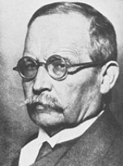
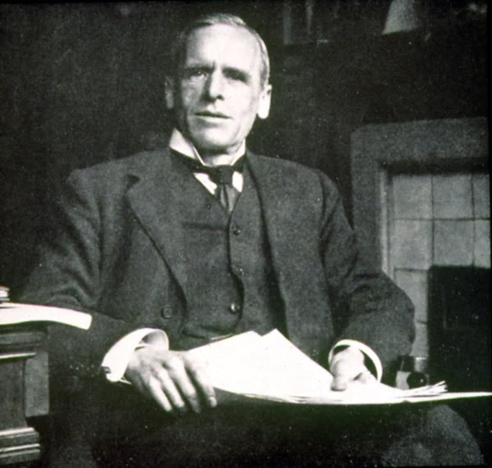
Frank-Starling law of the heart
Within physiological limits, the force of contraction of the heart is directly proportional to the initial length of the muscle fibre
Otto Frank
1865-1944
Ernest Starling
1866-1927
D de Silva

Slide 13
What does this mean?
Increase in venous return
Increase in the end diastolic volume
Increase in stretch of ventricle
Increase in stroke volume
Increase in cardiac output
D de Silva

Slide 14
Implication of Starling’s Law
The heart pumps out
what it receives
(within physiological limits)

Slide 15
Increase venous return
Decrease venous return
Increasing venous tone
  Contraction of the venous smooth muscle
Muscle pump
  Contraction of skeletal muscles
Respiratory pump
  -ve intrathoracic pressure & +ve abdominal pressure during inspiration pulls blood towards thorax
Increased atrial contraction
Increase in blood volume
Reducing venous tone (dilatation)
Standing
Reduced blood volume
Increased pericardial pressure (pericardial effusion)
Reduced cardiac muscle stretching

Slide 16

D de Silva

Slide 17
2. Increasing cardiac contractility
Increasing the strength of contraction at any given length of the cardiac muscle
  Increase sympathetic stimulation to the ventricles
    Via sympathetic nerves or circulating catecholamines
    Acting on β1 receptors
  Hypertrophy of the heart muscle
  Increase intracellular Ca++
  Drugs (Digoxin, theophylline)

Slide 18
Reduced cardiac contractility
Reduced temperature
Acidosis
High CO₂
Low O₂
Drugs
Cardiac failure
D de Silva

Slide 19
Factors altering myocardial contractility
Increase
Circulating catecholamines
Sympathetic nerve stimulation
Inotropic drugs
Decrease
Loss of myocardium
Low [oxygen], high [carbondioxide], acidosis
Drugs that are negatively inotropic

Slide 20
Cardiac output curves
Increased SV by sympathetic stimulation
Decreased stroke volume by reducing sympathetic stimulation
Stroke volume
Ventricular
End diastolic volume
D de Silva

Slide 21
3. Afterload
Pressure in arterial circulation that resists ejection of blood
The pressure in the ventricles > aortic (or pulmonary artery) pressure for ejection of blood
  Increased pressure (afterload) reduces stroke volume
  Reduced pressure (afterload) increases stroke volume
D de Silva

Slide 22
Afterload is determined by the aortic pressure
Increased aortic pressure
increased resistance to flow
Increase in aortic pressure
Increased afterload
Reduced stroke volume
Reduced aortic pressure
reduced resistance to flow
D de Silva

Slide 23
In life, as the afterload increases, the volume of blood left in the ventricle increases
This results in a greater stretching of the ventricle and contractility of the heart
If the cardiac output +/- the peripheral resistance is increased, the blood pressure rises
D de Silva

Slide 24
Cardiac Index
The cardiac output per min per square metre of body surface area
Approximately 3.2L/min
Correlation between the body surface area and CO
Comparison with adult males | Cardiac Output | Cardiac Index
Babies | ↓ | ↑
Females | ↓ | ↑
Elderly | ↓ | ↑

Slide 25
Ejection fraction
Percentage of the end diastolic volume that is ejected during systole
Normally around 65%
Reduced in cardiac failure
Identify factors that will increase the ejection fraction
D de Silva

Slide 26
Measuring the Cardiac output
Echocardiography and doppler
  Most often used
Direct Fick method
  Invasive
  CO = Oxygen consumption/Arterio- venous oxygen difference
Indicator dilution technique
  Inject substance to vein and measure its concentration in arterial blood
  Plotted on a logarithmic graph and calculated to volume /min
  Thermodilution (using cold saline) is easier/ safer
D de Silva

Slide 27
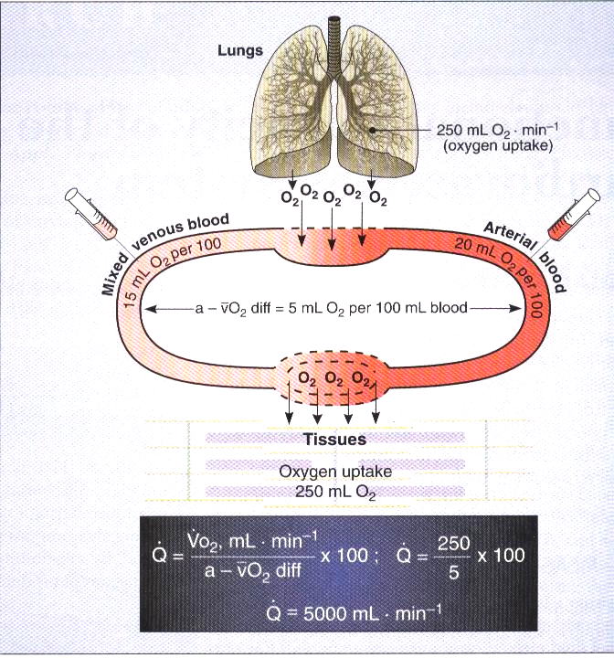

Slide 28
Later lectures....
Cover what happens to the cardiac output during
Exercise
Shock
Cardiac failure
D de Silva

